Slide 1

Data Analytics Bootcamp
Project 1 | Group 4
2021
Notes:
BG

Slide 2

World Happiness
Report
2015 - 2019
Notes:
BG

Slide 3
Meet the Team
Alysha Snowden
Alvin Lucero
Bec Gould
Ernest Bondi
Notes:
BG
Include the name of the Project and Group Members

Slide 4
Contents
Introduction
Hypothesis & Questions
Data Clean-up & Exploration
Data Analysis
Discussion
Post Mortem
Notes:
BG
Just some housekeeping – please post questions in the chat and we will answer them in our Q&A.

Slide 5
Introduction:
As a global society, we are waking up to the fact that happiness in our daily lives is extremely important. The positive effects of a balanced mind spread not only throughout a person's life, but also throughout society in a stone-in-the-pond figure of speech.
Corporations, governments, and organisations are becoming increasingly aware of the importance of happiness. It could be noted that when minimum satisfaction standards are reached people are better able to contribute to their day to day lives and respective duties, and that it is also in their best interests to contribute to people's well-being. As a result, satisfaction metrics are constantly being used in policy decisions all around the globe.
The World Happiness Report is a publication of the Sustainable Development Solutions Network, powered by data from the Gallup World Poll and Lloyd’s Register Foundation, who provided access to the World Risk Poll.
The purpose of this project is to dive in and analyse the happiness score per country around the world and the main characteristics of what forms “Happiness”.
Notes:
BG
Write overview of “happiness” and brief summary of the world happiness report
Detail Data sources used
Elaborate on the questions you asked, describing what kinds of data you needed to answer them, and where you found it
https://www.kaggle.com/mathurinache/world-happiness-report

Slide 6

Questions
Hypothesis:
H0:Happiness has no relationship with Economy (GDP per capita)
Where are the ten Happiest Countries in the world?
Why are they the Happiest Countries?
Where does Australia rank in the world?
Notes:
BG

Slide 7


Data Source
https://www.kaggle.com/mathurinache/world-happiness-report
Notes:
AL
Elaborate on the questions you asked, describing what kinds of data you needed to answer them, and where you found it

Slide 8
Data Clean-up & Exploration
Combined data from 2015 to 2019 using Jupyter notebook.
After the merge we identified that that some years of data did not have regions. We used V look up in the csv file to add in the missing region values.
Dropped countries with missing data
Renamed the headers
Created data frames for each variable to calculate the mean
Outputted csv file
Notes:
AL
Describe the exploration and clean-up process
Discuss insights you had while exploring the data you didn’t anticipate
Discuss any problems that arose after exploring the data, and how you resolved them
Present the discuss interesting figures developed during exploration, ideally with the help of Jupyter Notebook

Slide 9
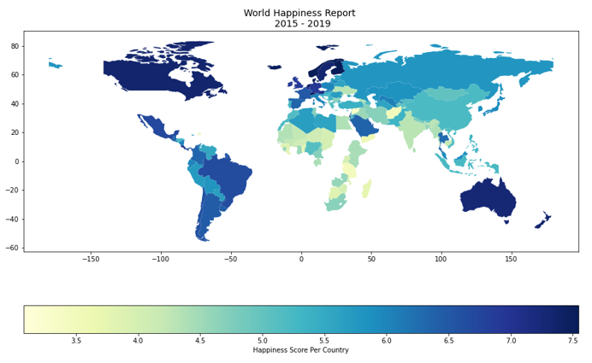
World Map:
Notes:
AS
Geopandas Choropleth Map

Slide 10
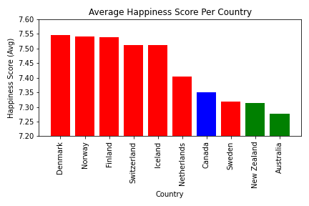
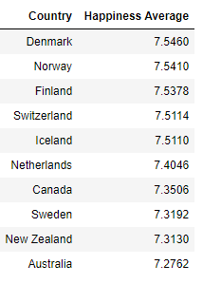
What are the top 10 happiest countries?
Notes:
AS

Slide 11
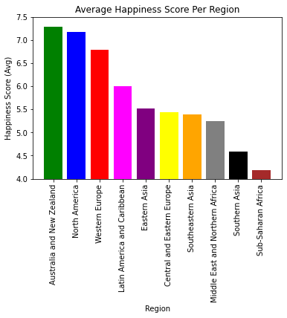
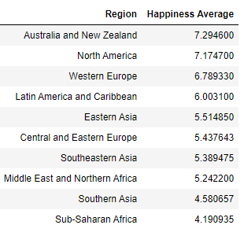
Which region has the highest happiness score?
Notes:
EB

Slide 12
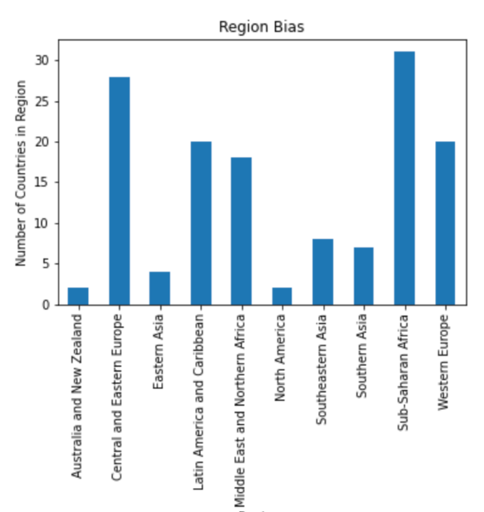
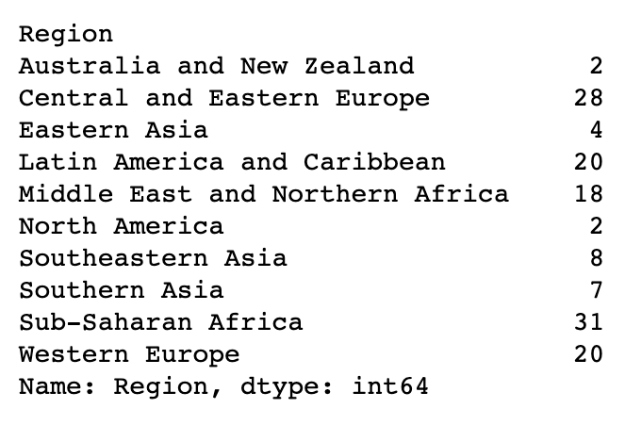
Breakdown of regions
Notes:
EB

Slide 13
What are the variables that are used to measure happiness?
Health (Life Expectancy)
Generosity
Trust (Government Corruption)
Family
Freedom
Economy (GDP per Capita)
Notes:
AS
Characteristics:
Trust (Government Corruption)
Generosity
Health (Life Expectancy)
Family
Freedom
Economy (GDP per Capita) -
GDP Gross Domestic Product
Definition: GDP is the final value of the goods and services produced within the geographic boundaries of a country during a specified period of time, normally a year. GDP growth rate is an important indicator of the economic performance of a country.

Slide 14
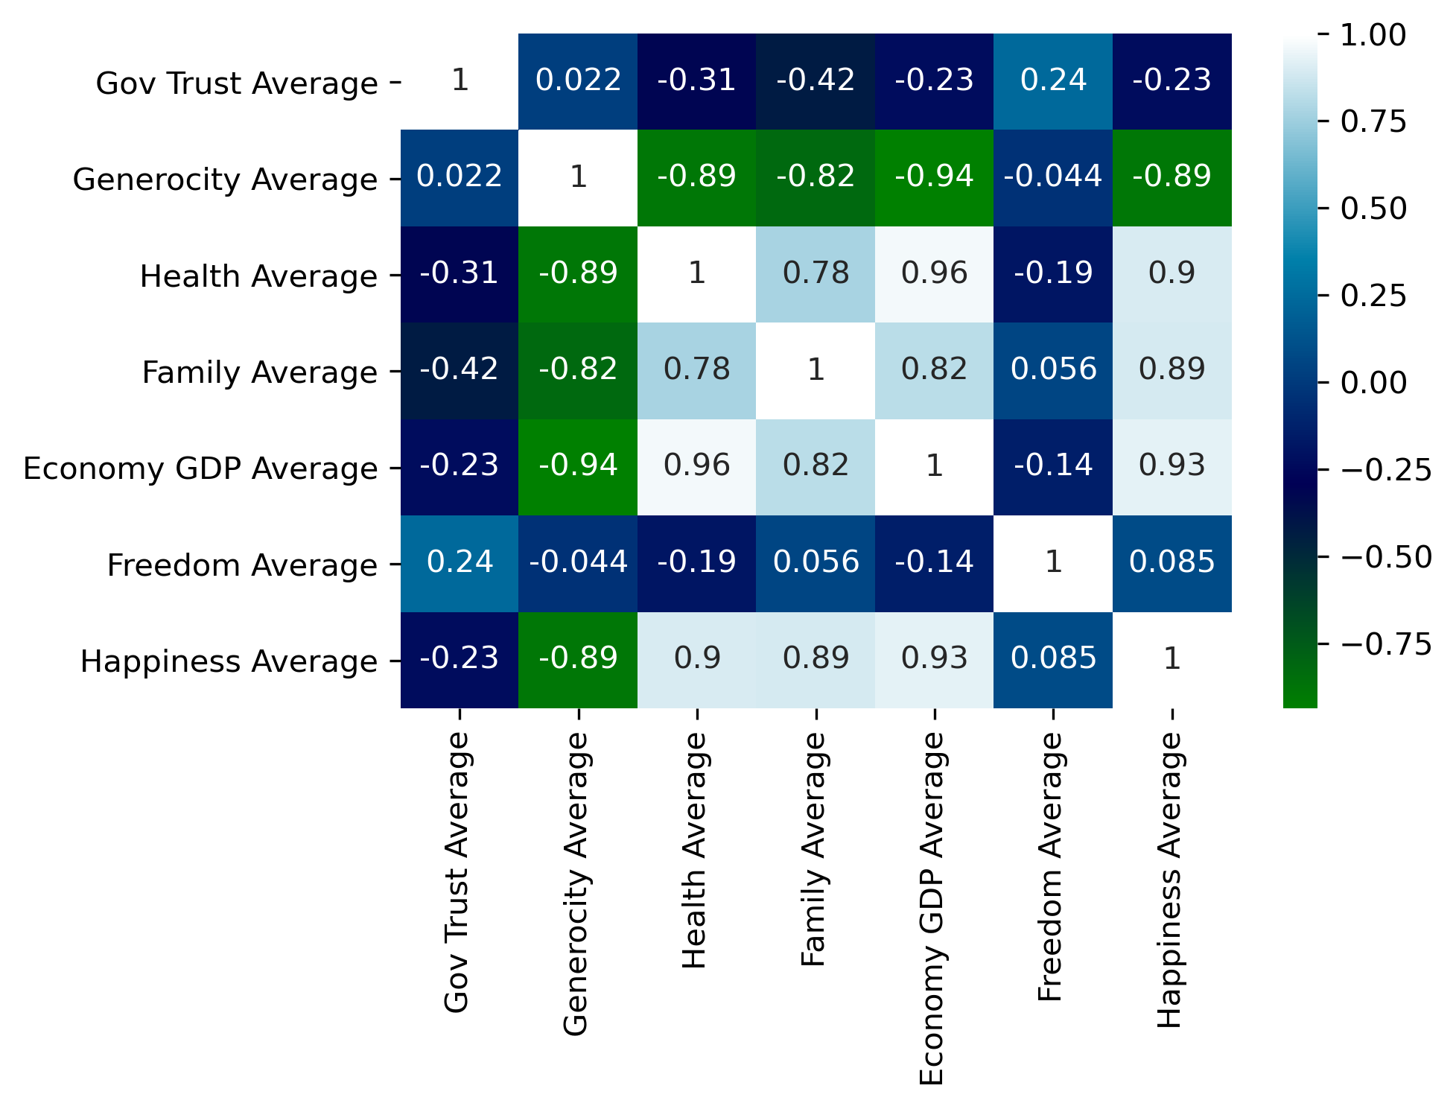
Why are they the happiest countries?
Economy GDP
Health
Family
Notes:
AS
Seaborn Correlation Heatmap

Slide 15
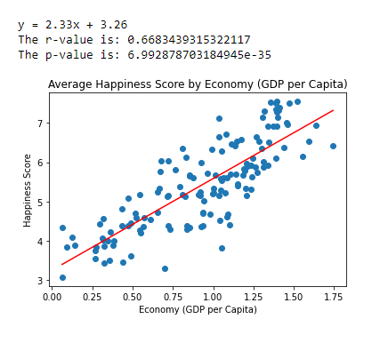
Does Economy (GDP Per Capita) correlate with happiness score?
Notes:
EB

Slide 16
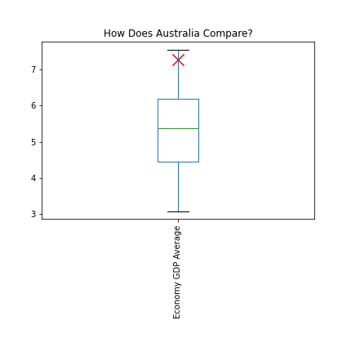
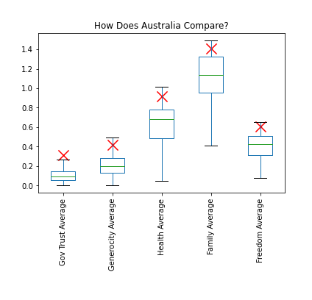
Where does Australia rank in the world?
Notes:
AL

Slide 17
Discussion
Australia is in the top 10 happiest countries.
Australia sits above the mean for each variable.
The happiest region is Australia and New Zealand
7 of the top 10 happiest countries are from one region however, that region only ranked third happiest.
The P value is less than 5% so we reject the null hypothesis and conclude that there is a relationship between Happiness and Economy (GDP per Capita).
Notes:
AL
Discuss your findings. Did you find what you expected to Find? If not, why not? What interferences or general conclusions can you draw from your analysis.

Slide 18
Post Mortem
We originally planned on doing our project on Covid and how it affected the suicide rate, the divorce rate and was there an increase in births. We had issues with trying to find the data and also current data.
Alysha identified a problem with the data when completing the correlation heat map. Our code was calling the incorrect data frame and was resulting in the incorrect figures being generated.
We identified a bias in the data as some regions have multiple countries and others only have two e.g. Australia and New Zealand.
If we had more time we would have cleaned the data more. For example, update the Country names so they are all matching. The heat map has missing data due to names not matching our data set. E.g. United Sates and United States of America.
Notes:
BG
Discuss any difficulties that arose, and how you dealt with them.
Discuss any additional questions that came up, but which you didn’t have time to answer. What would you research next, if you had two more weeks

Slide 19

Notes:
Open floor Q&A with the audience

